Slide 1
Donation AND Shelter Management System
Team Members :
Nikhil Joshi (001302532)
Utkarsh Kakkar (001029458)
Mihir Patel (001084566)

Slide 2
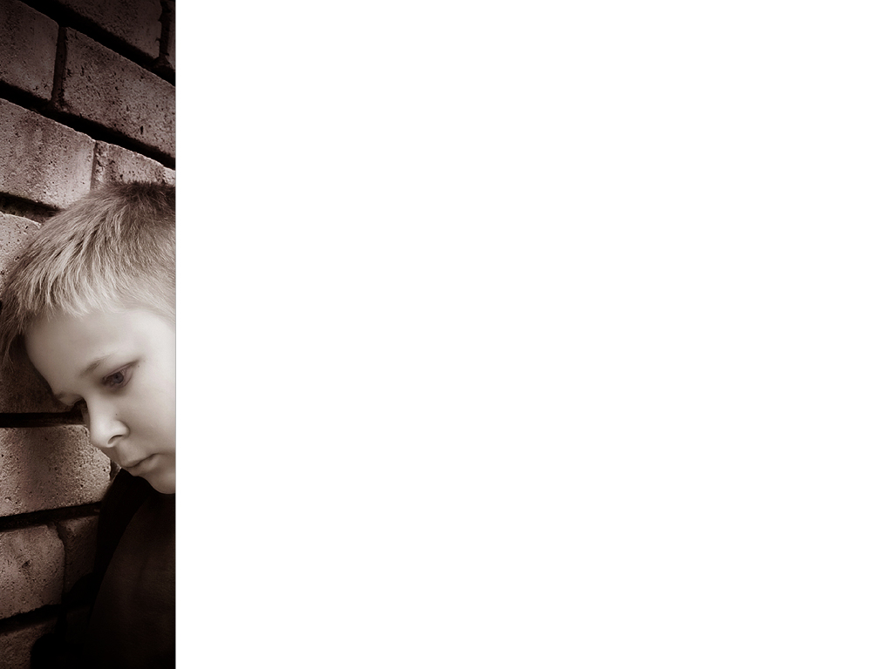
Problem Statement
Orphanage provides safe havens to orphan children
Normally this community looks forward to care of children who are exploited socially.
To facilitate basic needs of children like supply of food, shelter and education.
Also, adoption process is ruined due lack of awareness in adopters
Making this process transparent and accountable is one most essential mission of Orphanage.

Slide 3
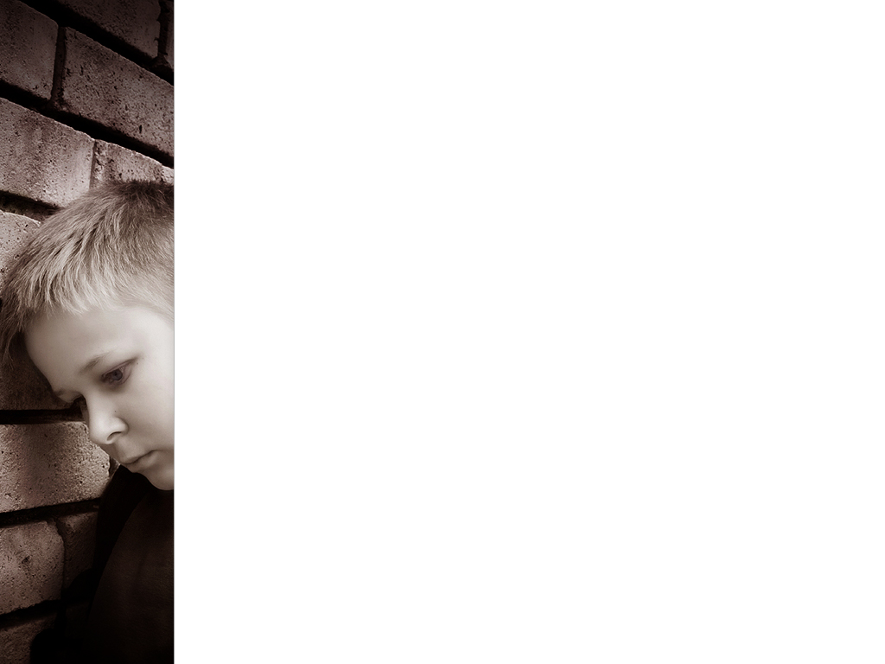
Solution
Donation and Shelter Management System addresses the below issues faced by children.
For dealing with basic needs of children we designed system that keeps track of education and healthcare needs, wherein if any child needs medical attention he sent to doctor who treats the problem and gives the medicine.
To keep cash flow unhindered to orphanage we have in place public donation and advertisers that always are in position to donate adequate amount of funds.
In order to imbibe transparency in adoption process we develop a architecture that stores all information about the child and the person adopting it.

Slide 4
Our Thought Process
Adapting below approach we create different workflow requests to process different needs of children.

Slide 5
Use case
System admin: He will perform duties given below for complete designed ecosystem
Create network : Here Cities in which Orphanage requires help will be created
Create enterprise : This will look after the governing bodies of Orphanage
Create new user login : Enabling a secure user to login, thus maintaining confidentiality of data

Slide 6
Enterprise Admin
Every Governing Body(Enterprise) will have its head operating the daily course of activities.
Creating Users and their login ids will be the primary task of the admin.
Ensuring only Admin logs in to system is crucial for smooth functioning of orphanage.

Slide 7
Roles Defined
Each component of ecosystem has its roles defined
Every Organization will take care of their individual roles.
This application consists of following set of roles like:
Doctor Role
Manage Role
Counsellor Role
Admin Role
Consultant Role
These roles connect different Enterprises and different Organizations across whole Ecosystem.

Slide 8
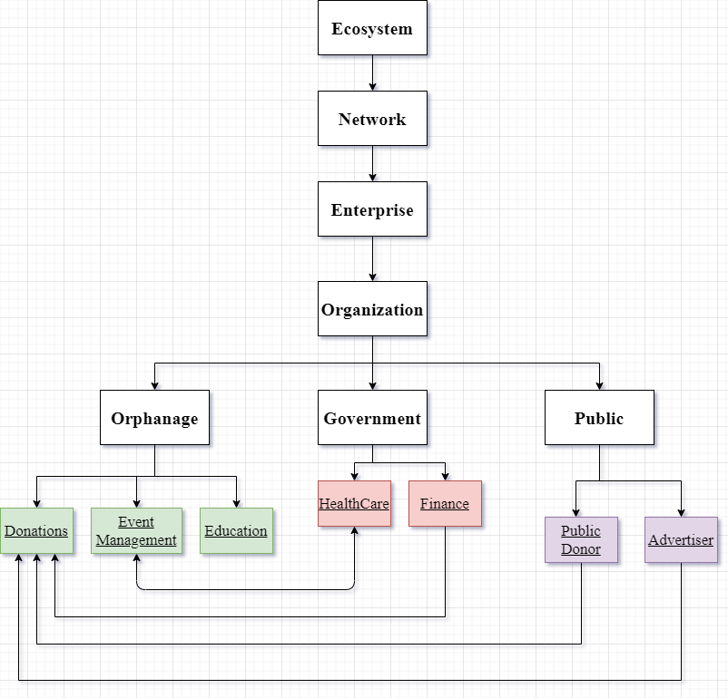
Object Model

Slide 9
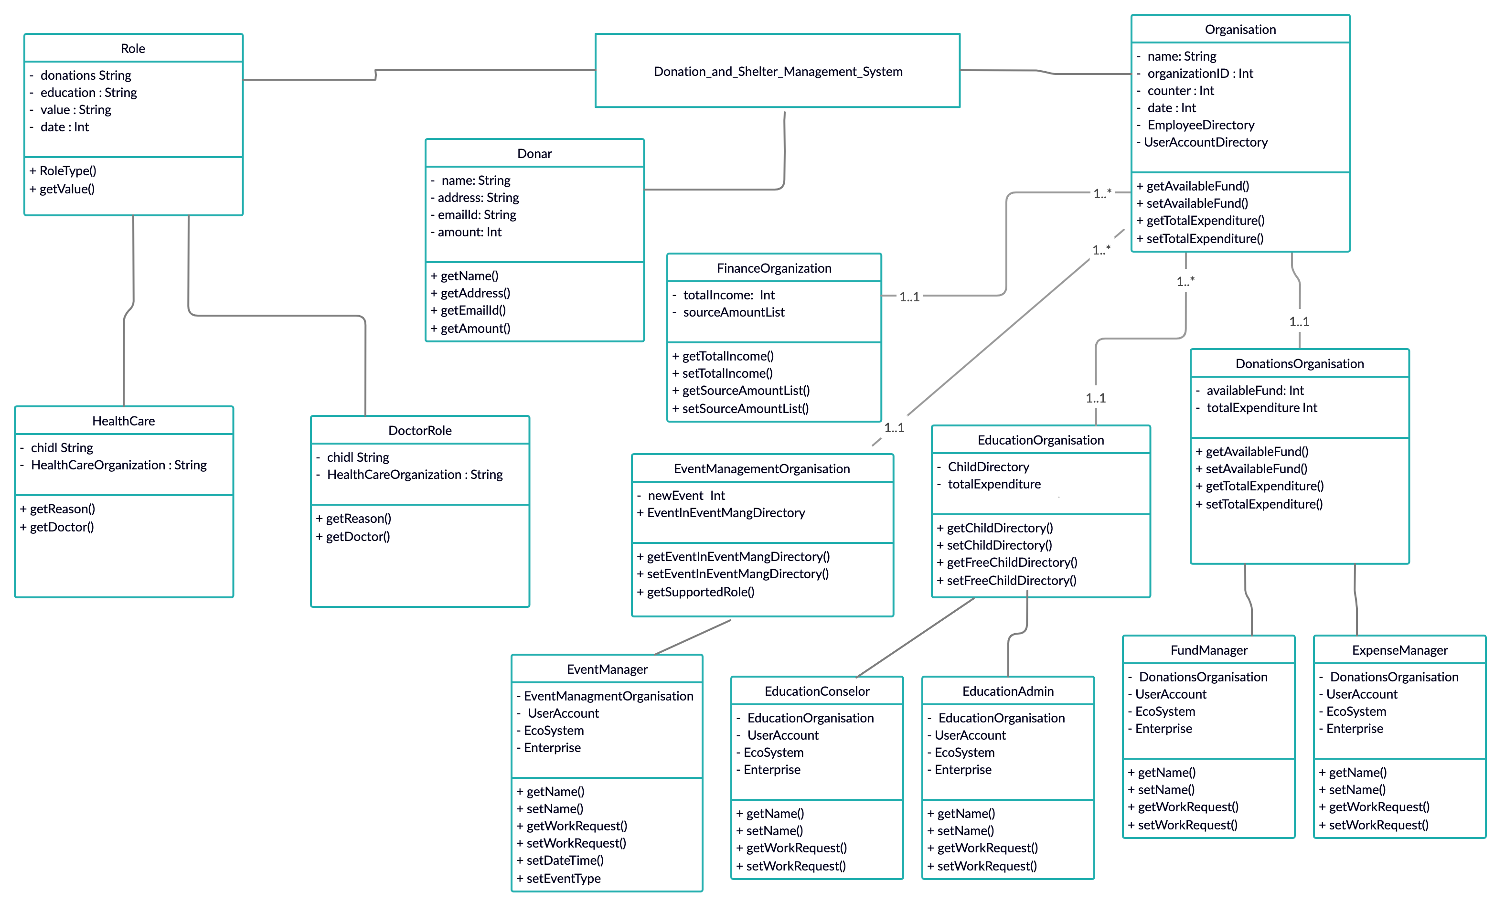
UML

Slide 10
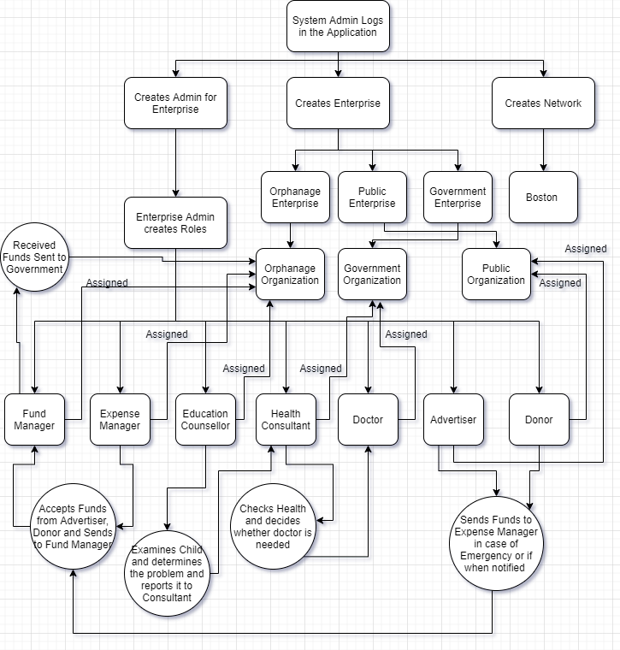
Working of Ecosystem

Slide 11
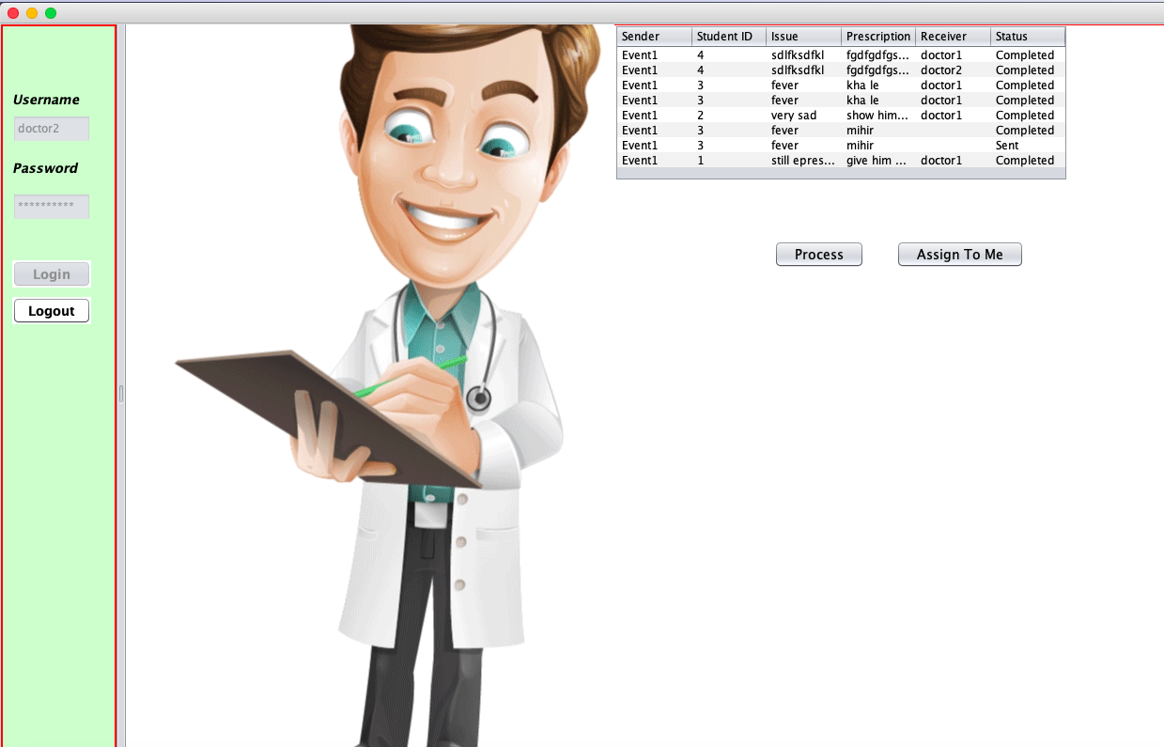
Doctor Screen 1

Slide 12
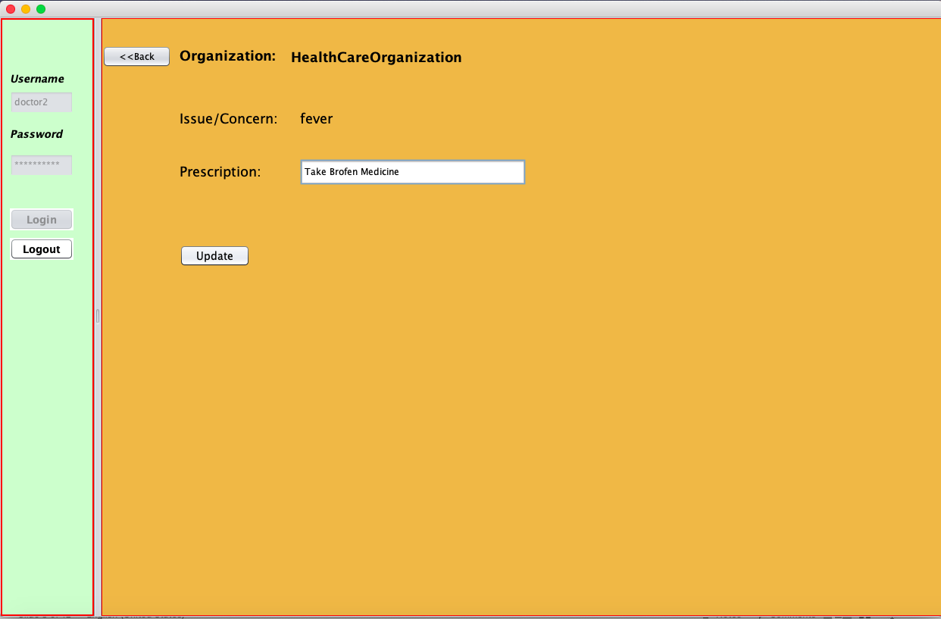
Doctor Screen 2

Slide 13
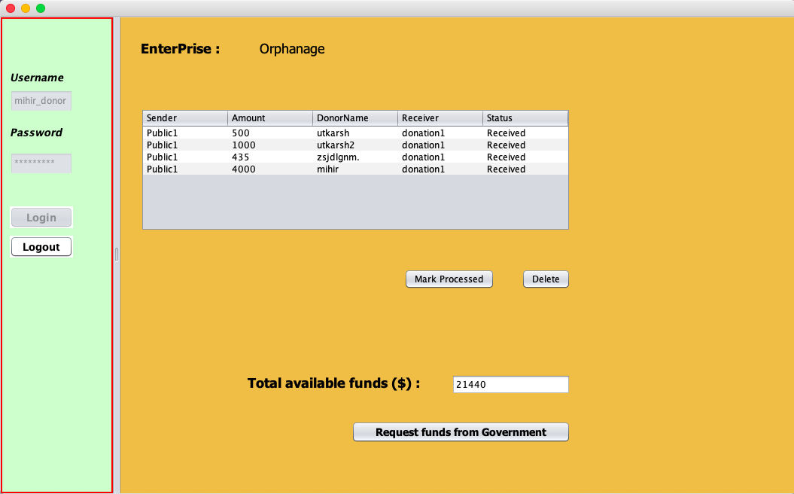
Donation Screen 1

Slide 14
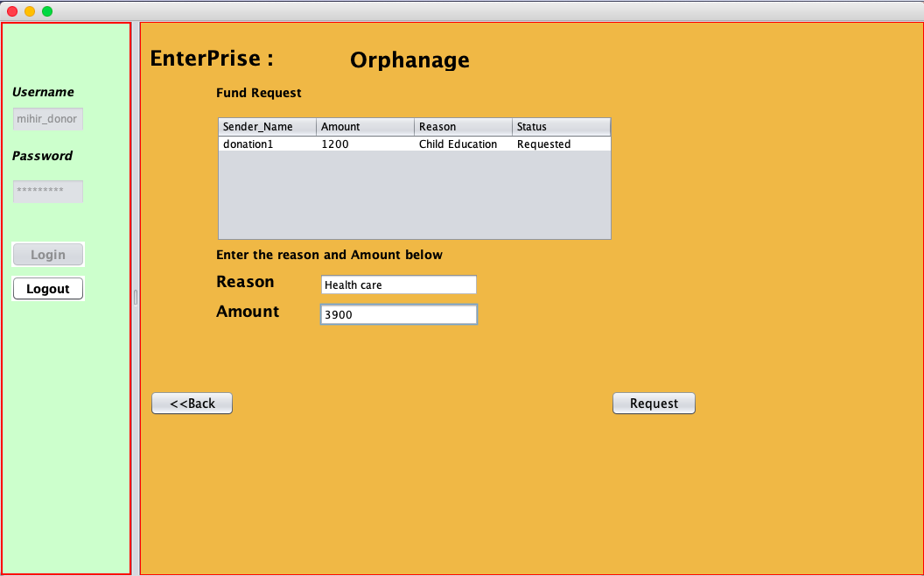
Donation Screen 2

Slide 15
Future Scope
The Application could be encompassed in different cities.
Donors from different parts of country can participate in the donation to orphanage.
Can be evaluated after adoption also like:
Child’s Health
Child’s Progress
Child’s Educational progress
Establishing a complete monitoring system which enables orphanage to improve its services.
Also, to implement spreading of awareness in masses related to child abuses and exploitation.

